Slide 1
Universal Response Engine: LLMs for Good
Team #35
Client: Ahmed Nazar
Advisor: Mohamed Selim

Slide 2
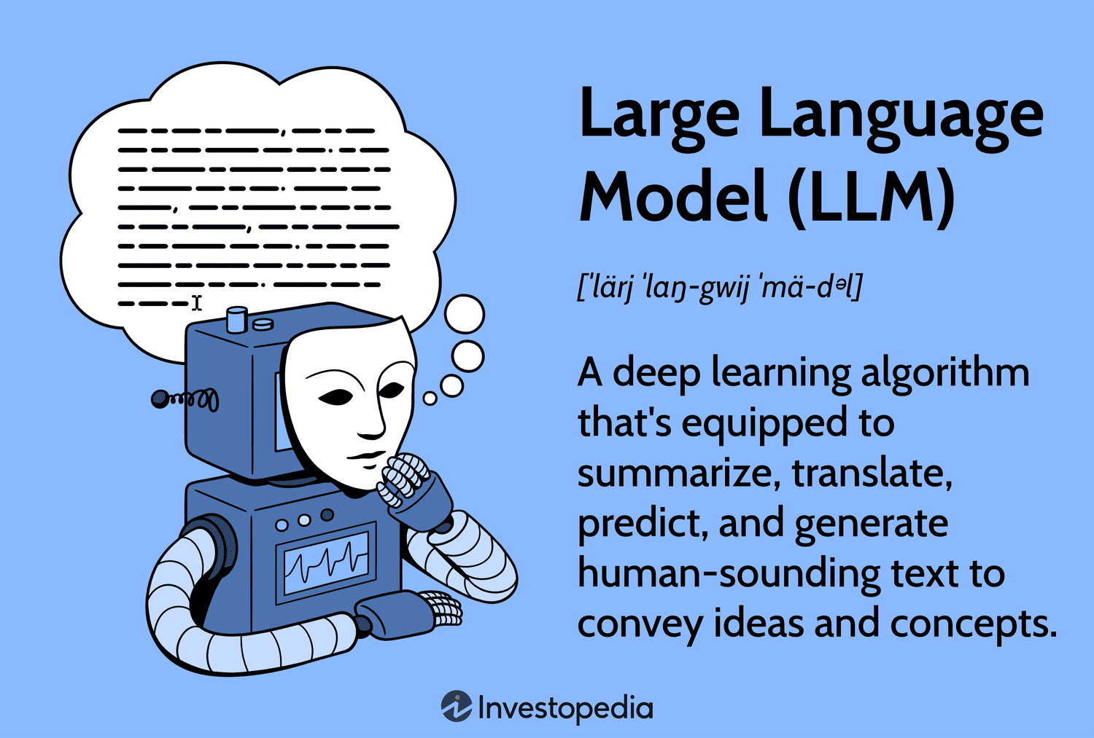
Notes:
What is an LLM?
Go back a few steps…
AI: broad term, intelligent machines
ML: subfield of AI, pattern recognition, predicting data
LLMs: subfield of ML, taking pattern recognition and a combination of other ideas to start generating text, like natural languages, and other data
How do LLMs work?
Combine lots of datasets
Feed data to a neural network that processes it with calculations (like calculating similarity between words)
Finetune it by training it on specific datasets

Slide 3
Project Overview
Creating an LLM for humanitarian use
Chatbot-like website where users provide questions/prompts
Model responds with relevant links, media, info (multimodal)
Notes:
Our project aims to address a critical gap in accessible and comprehensible support for individuals facing challenges. Many people experience difficult circumstances and may feel isolated when seeking help. Although there are a lot of good resources available, they are often fragmented and require these distraught people to sift through multiple pages of information from different sources.
What makes it different: societal good, open-source, no data tracking, to help people in vulnerable situations
Fine-tuned, trained, vetted on empathetic datasets that provide medical advice, emergency advice, etc.

Slide 4
Problem Statement
The lack of a comprehensive platform to provide support to the aforementioned people in need causes:
Increased stress and frustration
Inefficient use of time and energy
Potential oversight of crucial information/services
Inconsistent quality and reliability of info

Slide 5
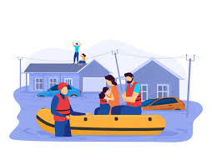
User Needs
Mental health questions
Medical assistance
Legal direction
Housing advice
Disaster information
Notes:
Someone is feeling helpless and they don’t have anyone to talk to, they can ask questions to the response engine and get resources and direction
Someone falls and gets cut on leg, send pic and ask what to do next to help the wound
Someone getting divorce, they can ask who gets to keep house after divorce
People in an area with natural disasters, being able to answer any questions (evacuation, safety) they have

Slide 6
Requirements
User Experience
Accessible design
Easy to understand layout
Users can input text and image queries
Knowledgeable, concise, and fast responses
Should create a sense of care and support
Technical
Access to internet and a web browser
Hosted on ISU servers
Ethical
Application does not store users’ private information
The LLM is vetted for appropriate responses
Datasets used contain appropriate and relevant information

Slide 7
Engineering Standards
ISO/IEC 27000: Information security management
ISO/IEC 42001: Artificial Intelligence Management System
IEEE Std 730-2014: Standard for Software Quality Assurance Processes
IEEE Std 1028-2008: Standard for Software Reviews and Audits
IEEE/ISO/IEC 26514-2021: Design and development of information for users

Slide 8
Conclusions
Our platform will provide users with concise answers to their queries and/or guide them to relevant resources.
We will prioritize user-centric design and ethical AI practices, while maintaining user privacy and data security.
This solution streamlines the help-seeking process while adhering to engineering standards and ethical guidelines.
Notes:
Our project will provide users with concise answers to their questions and guide them to relevant and recent resources.
We will prioritize user-centric design and Ethical AI practices such as unbiased, transparent, and reliable data, while maintaining user privacy and data security.
This solution streamlines the help-seeking process while adhering to engineering standards and ethical guidelines

